Slide 1
S-100 Validation Tests subgroup
16th VTC Meeting
20th October 2026

Slide 2
Meeting protocol
Meeting participants are kindly requested to note the following meeting protocols;
Please keep your camera and microphone turned “off” if you are not talking or presenting
If you want to make an intervention, please turn your camera and microphone on and, raise your hand to indicate that you wish to speak
Don’t forget to turn your microphone “on” before speaking, and “off” when finished
Please use the “Chat” function to communicate an text information to the meeting
If you have any problems connecting using Firefox or other browser – please try using Chrome.

Slide 3
AGENDA
Update from S-100 WG11
Work plan for Edition 2.0.0
Status on checks
Review outstanding items – ‘Help Wanted’
Other issues – if time
Next meeting

Slide 4
Update from S-100 WG11
8.1 - Subgroup report
PowerPoint Presentation
8.2 – Draft edition 2.0.0s
8.3 - Data Offset issue – A. Klemm is investigating (S-102) – report back 13th November
PowerPoint Presentation
S-100 WG Chair : Liz Hahessy (DK)
S-100 WG Vice Chairs: Benjamin Hell (SE) & Gabriela Balla (AU)

Slide 5
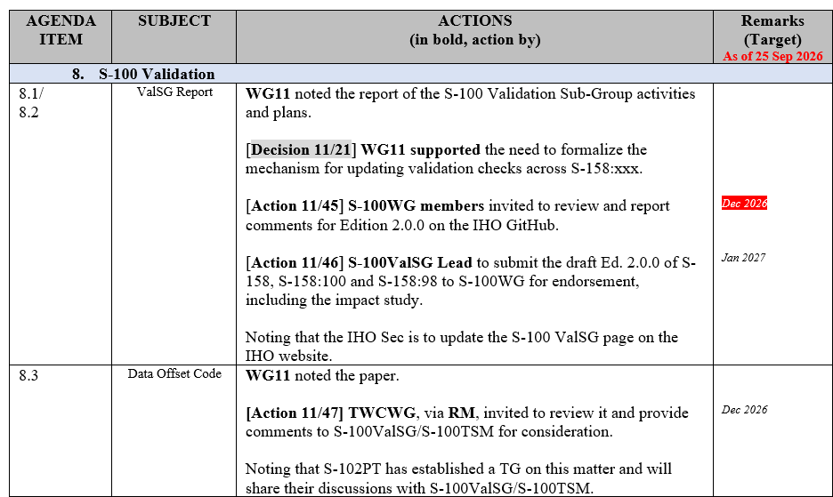
Actions from S-100 WG 11
[Action 11/19] S-100WG Chair to update the change proposal template, considering also impact on validation

Slide 6
Work plan for Edition 2.0.0
 | Edition 2.0.0 | Status
1.1 | Kick off using funds for edition 2.0.0 & project outline | Complete
1.2 | Initiate work | Complete
1.3 | Update for S-100 5.2.1 | Complete
1.4 | Review GitHub issues for inclusion | In Progress
1.5 | Review S-98 Data Constraints Annex for Edition 2.0.0 | In Progress
1.6 | Review S-58 for potential changes, primarily classifications | In Progress
1.7 | Coordinate with S-158:1xx regarding versioning concerns | To do
1.8 | Circulation for comment | Draft version ready for review – In Progress
1.9 | Approval to S-100 WG – draft version | To do
1.10 | Approval from S-100 WG via circular letter | To do Final drafts due 30/12
1.11 | User impact study | To do
1.12 | HSSC endorsement | To do

Slide 7
Draft edition 2.0.0
Updated yesterday
Versions are up on GitHub
S-100-Validation-Checks/Documents/S-158-100/2.0.0 at main · iho-ohi/S-100-Validation-Checks · GitHub
S-100-Validation-Checks/Documents/S-158-98/2.0.0 at main · iho-ohi/S-100-Validation-Checks · GitHub
S-100-Validation-Checks/Documents/S-158/2.0.0 at main · iho-ohi/S-100-Validation-Checks · GitHub
Changes marked in red
  Standardised wording changes not on GitHub
Would really like feedback by 18th November
  Contract time limited

Slide 8
5.2.2 changes
Reviewing actions to see if any are required, potentially later in Edition 2.0.0 if the timing doesn’t work.
20 possible changes required
Checks arising from amendments to 5.2.1 approved at S-100 WG11 · Issue #161 · iho-ohi/S-100-Validation-Checks · GitHub

Slide 9
S-58 Edition 9.0.0 checks #159
Checks from S-58 Edition 9.0.0 · Issue #159 · iho-ohi/S-100-Validation-Checks
2 issues
  S-58 Check 102 – Record length
    See what happens at ENC WG meeting
    Possibly a Collection D check (generic) or push to S-101
  551c- Text attribute using C1 characters prohibited

Slide 10
Collection c & d
Collection C (help wanted issue)
Collection C checks are those which cannot be implemented in the traditional way, that is, by purely software processing of the subject, be it dataset, support file, or exchange set. Such checks will include:
  checks which require external information, e.g., tracking previously issued updates
  checks which require visual inspection or other non-software based means of testing, either in full or part
  Move to a Register Check when ready
Collection D (will come back to)
Checks that mention the Product Specification
  Suggestion is to make a list and then the PS validation owners can choose whether to include or not
  Will not be included in main S-158:100 checks, could potentially split out to another document, so not causing updates to S-158:100

Slide 11
Outstanding issues and topics
70 open issues in GitHub
  11 ‘Help Wanted’ – indicate priority issue for discussion
  42 Fix drafted
iho-ohi/S-100-Validation-Checks: S-100 Github repository for Validation Check development.

Slide 12
Use of ‘product specification’
Identifying examples of where it says ….. S-100 spec or product specification
  Does the subgroup agree?
  20+ checks
Checks in S-158:100 which mention the Product Specification · Issue #160 · iho-ohi/S-100-Validation-Checks · GitHub

Slide 13
Requirements for Infrastructure / artefacts
List-form display as in Excel lists of checks for Edition 2.
Provide for additional product-specific fields in checks.
Provide for associating an optional free-text or structured annotation (for example a table) to each check.
Designate checks as common to multiple data products.
Select checks by data product or generic S-100 checks and the edition to which a check is applicable, in addition to the introduced/modified/deleted fields
Text search of Message, Description, and Solution fields.
Export results in spreadsheet (or at least CSV?) and XML
  Export as Word, HTML or PDF document (only if need is identified)?
  Select fields to be exported
Add Key Terms field to facilitate search – allow S-158:... authors to tag checks with terms which provide more details than the standard fields, such as “root group”, “regular grid”, etc.
  Provide for a standardized but easily expandable list of key terms.
Other requirements?

Slide 14
Next meetings
Next VTC meeting:
November 18th?
November 24th?
GitHub – focus on ‘help wanted’ and ‘fix drafted’
Feedback on draft edition 2.0.0 - 18th November

Slide 15
Control flow dependency #157 & 158
If upper level fails, then no need to check
Suggested:
  Prerequiste column
  Terminate if True
158 a bit more complex

